Slide 1
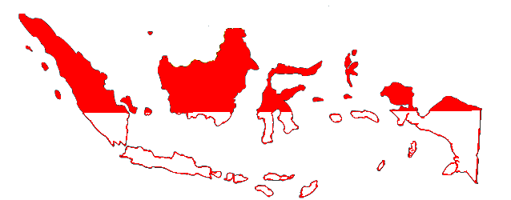
WELCOME TO INDONESIA

Slide 2
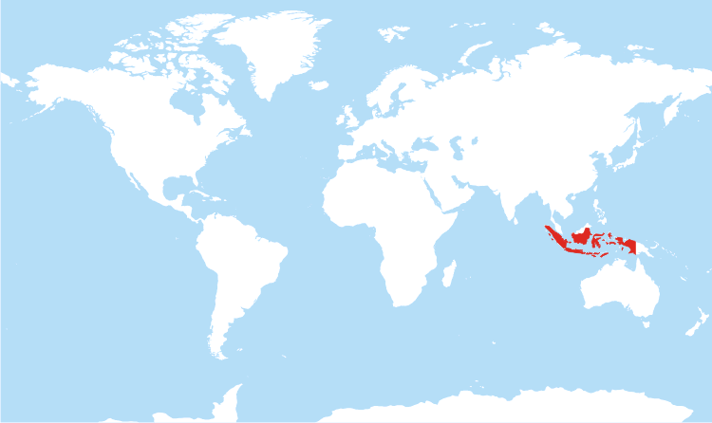
INDONESIA ON WORLD MAP
Indonesia is between Australia and Asia

Slide 3
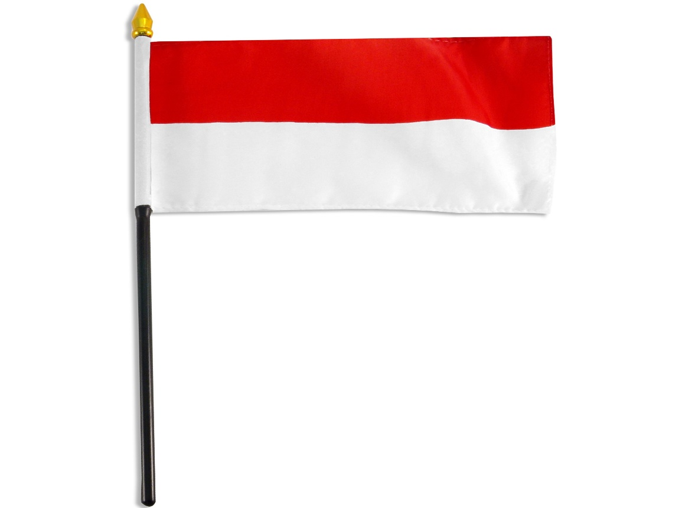
FLAG
A simple flag with red and white bands.

Slide 4
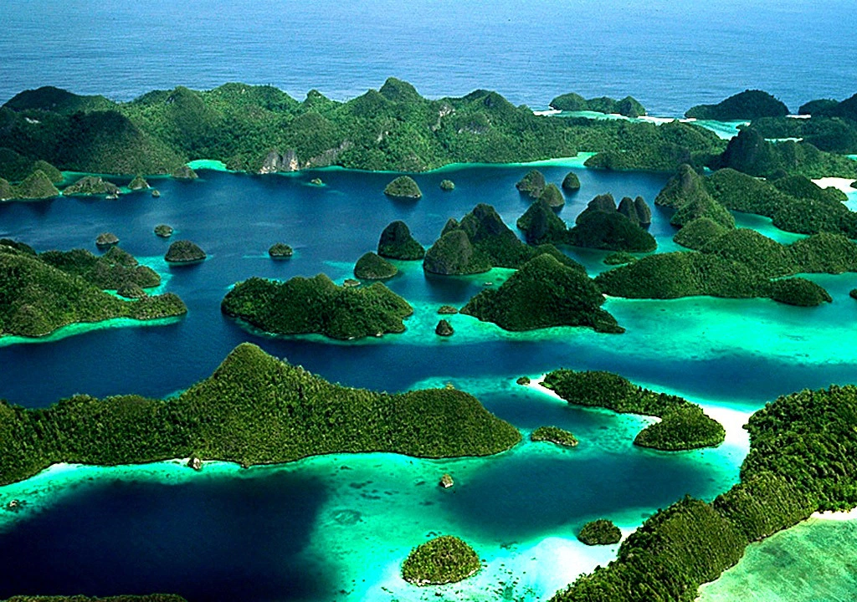
MAJOR ISLANDS
Indonesia has around 17,500 islands and most don’t have names.
The major islands are
Java
Sumatra
Borneo
New Guinea

Slide 5
LARGEST CITIES
Largest cities of Indonesia are:
Jakarta
Surabaya
Bandung
Medan
Semarang

Slide 6
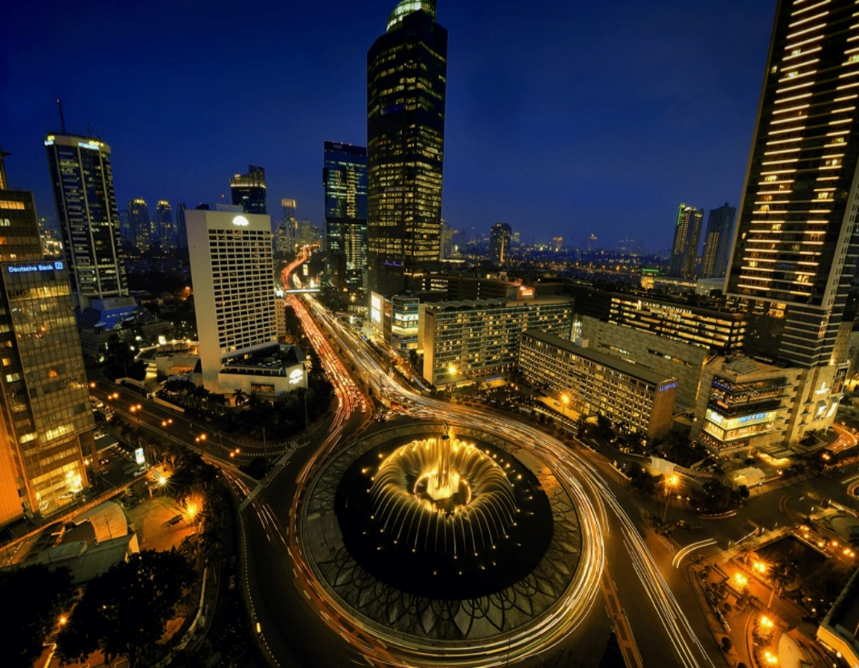
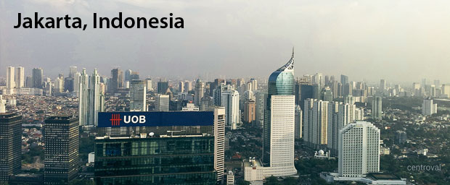
CAPITAL OF INDONESIA
Jakarta is the capital of Indonesia

Slide 7
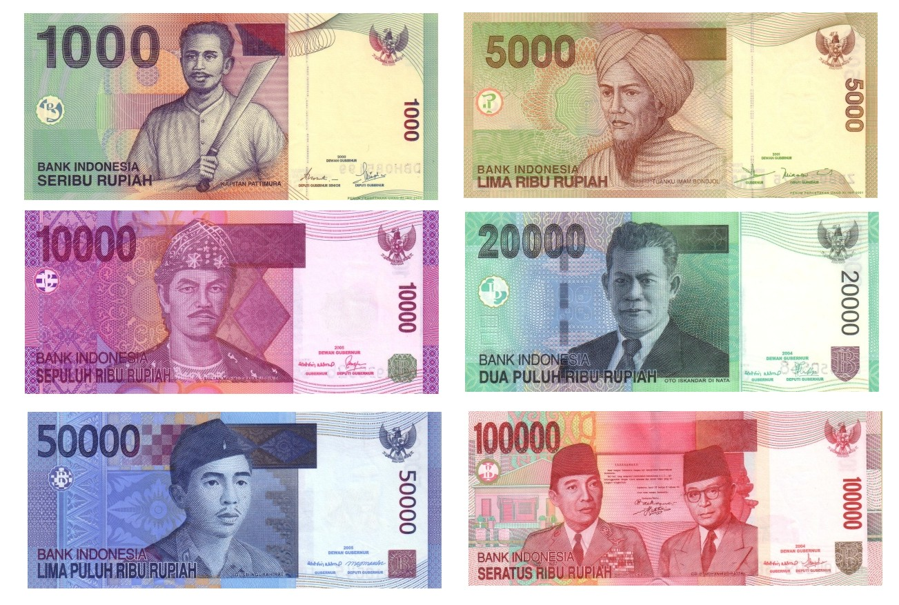
CURRENCY
The currency is Indonesian Rupiah

Slide 8
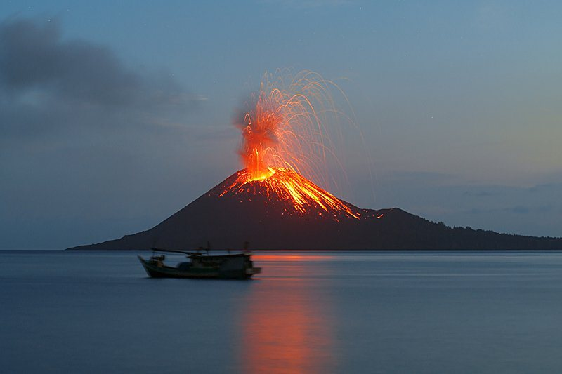
VOLCANOES
There are 400 volcanoes in Indonesia
There are 150 live volcanoes

Slide 9
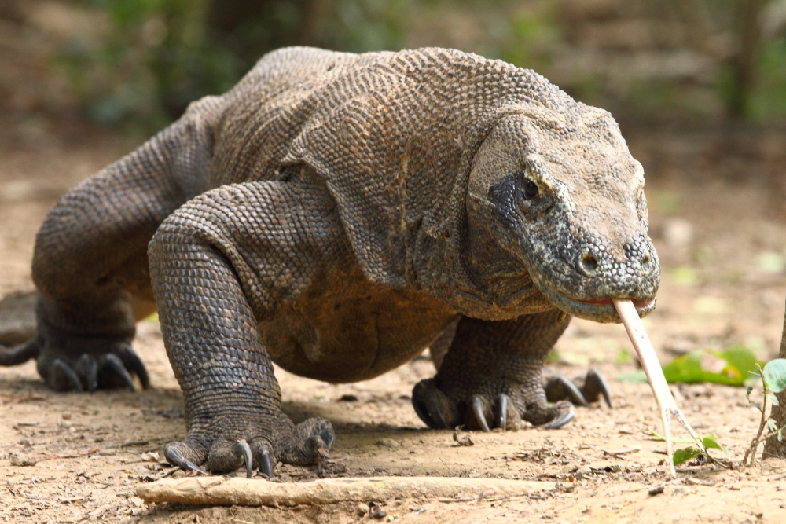
NATIONAL ANIMAL
Komodo Dragon is the national animal

Slide 10
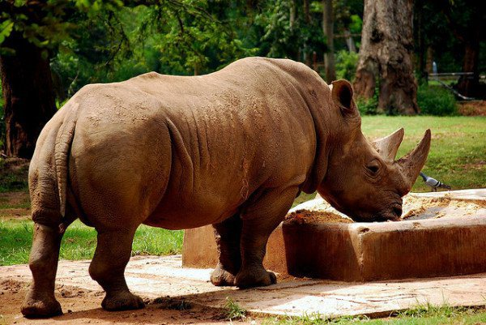
JAVAN RHINO
Javan Rhino only lives in Indonesia

Slide 11
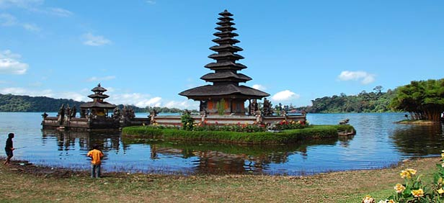
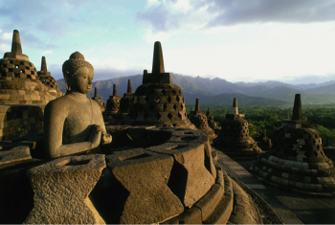
TOURISM
Indonesia is famous for beaches and temples.
Bali is a famous holiday destination.

Slide 12
THE END.
THANK YOU!

